Slide 1
CS 412 Intro. to Data Mining
Chapter 2. Getting to Know Your Data
Qi Li, Computer Science, Univ. Illinois at Urbana-Champaign, 2018

Slide 2
Chapter 2. Getting to Know Your Data
Data Objects and Attribute Types
Basic Statistical Descriptions of Data
Data Visualization
Measuring Data Similarity and Correlation
Summary

Slide 3
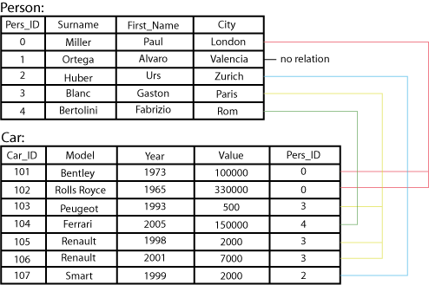
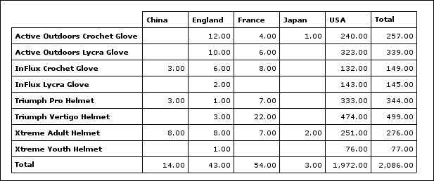
Types of Data Sets: (1) Record Data
Relational records
Relational tables, highly structured
Data matrix, e.g., numerical matrix, crosstabs
Transaction data
Document data: Term-frequency vector (matrix) of text documents

Slide 4
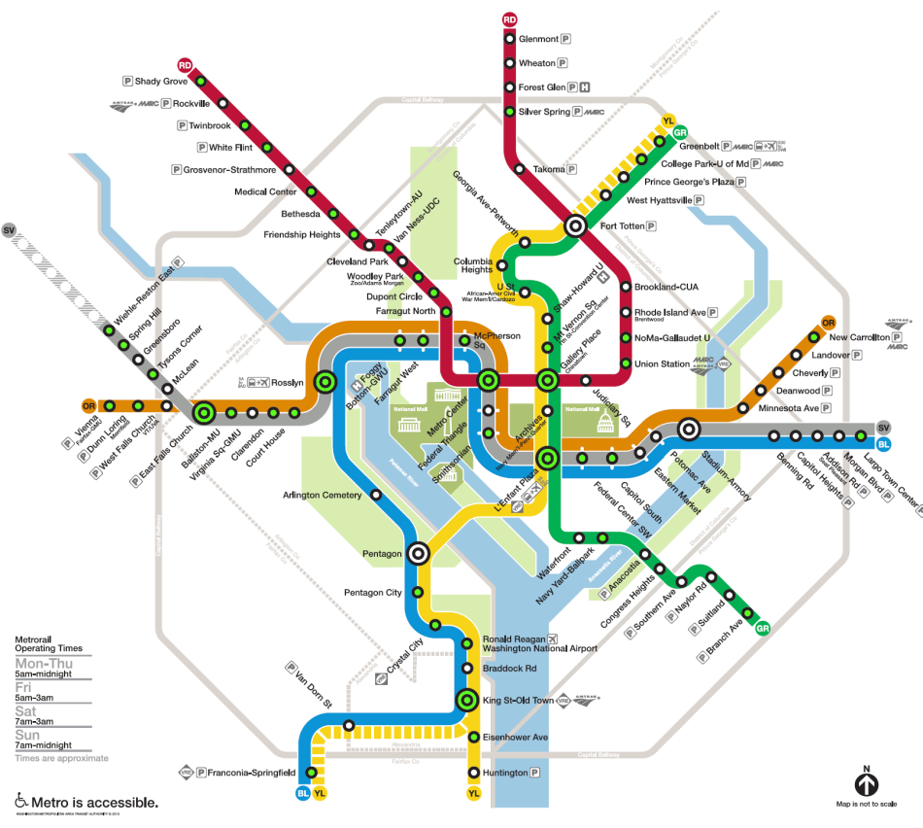

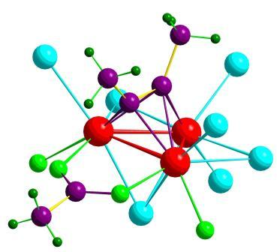

Types of Data Sets: (2) Graphs and Networks
Transportation network
World Wide Web
Molecular Structures
Social or information networks

Slide 5
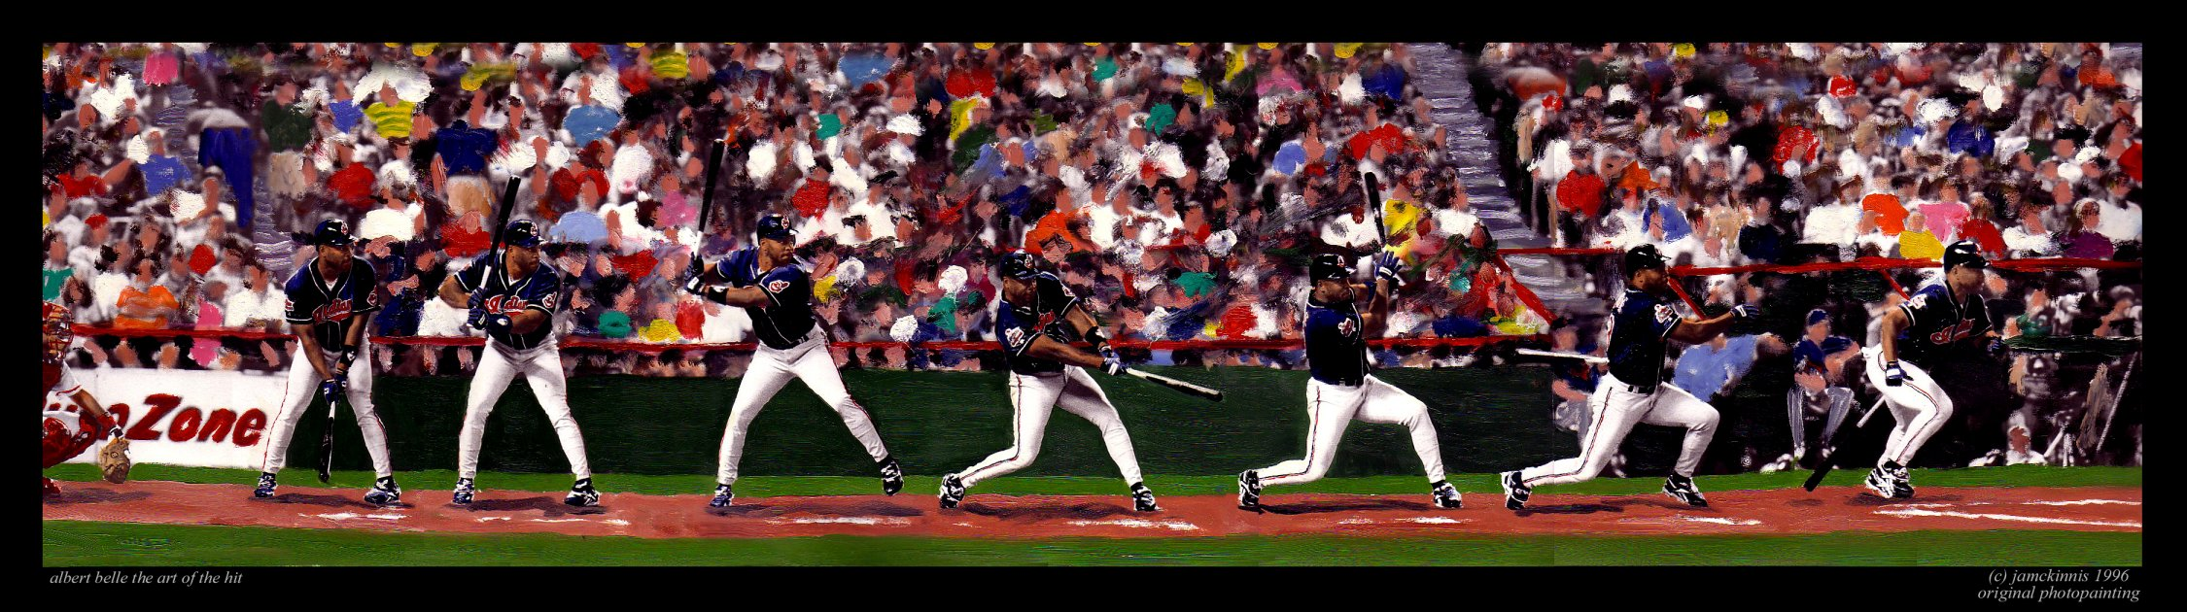
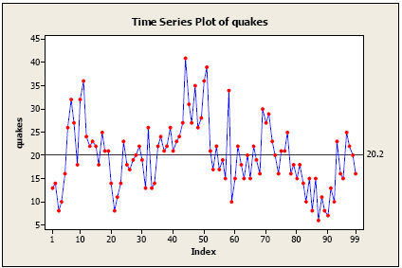
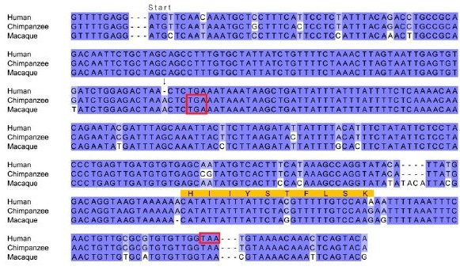
Types of Data Sets: (3) Ordered Data
Video data: sequence of images
Temporal data: time-series
Sequential Data: transaction sequences
Genetic sequence data

Slide 6
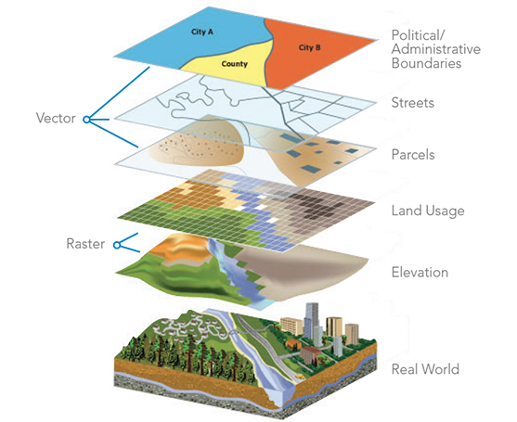

Types of Data Sets: (4) Spatial, image and multimedia Data
Spatial data: maps
Image data:
Video data:

Slide 7
Important Characteristics of Structured Data
Dimensionality
Curse of dimensionality
Sparsity
Only presence counts
Resolution
Patterns depend on the scale
Distribution
Centrality and dispersion

Slide 8
Data Objects
Data sets are made up of data objects
A data object represents an entity
Examples:
sales database: customers, store items, sales
medical database: patients, treatments
university database: students, professors, courses
Also called samples , examples, instances, data points, objects, tuples
Data objects are described by attributes
Database rows → data objects; columns → attributes

Slide 9
Attributes
Attribute (or dimensions, features, variables)
A data field, representing a characteristic or feature of a data object.
E.g., customer _ID, name, address
Types:
Nominal (e.g., red, blue)
Binary (e.g., {true, false})
Ordinal (e.g., {freshman, sophomore, junior, senior})
Numeric: quantitative
Interval-scaled: 100○C is interval scales
Ratio-scaled: 100○K is ratio scaled since it is twice as high as 50 ○K

Slide 10
Attribute Types
Nominal: categories, states, or “names of things”
Hair_color = {auburn, black, blond, brown, grey, red, white}
marital status, occupation, ID numbers, zip codes
Binary
Nominal attribute with only 2 states (0 and 1)
Symmetric binary: both outcomes equally important
e.g., gender
Asymmetric binary: outcomes not equally important.
e.g., medical test (positive vs. negative)
Convention: assign 1 to most important outcome (e.g., HIV positive)
Ordinal
Values have a meaningful order (ranking) but magnitude between successive values is not known
Size = {small, medium, large}, grades, army rankings

Slide 11
Numeric Attribute Types
Quantity (integer or real-valued)
Interval
Measured on a scale of equal-sized units
Values have order
E.g., temperature in C˚or F˚, calendar dates
No true zero-point
Ratio
Inherent zero-point
We can speak of values as being an order of magnitude larger than the unit of measurement (10 K˚ is twice as high as 5 K˚).
e.g., temperature in Kelvin, length, counts, monetary quantities

Slide 12
Discrete vs. Continuous Attributes
Discrete Attribute
Has only a finite or countably infinite set of values
E.g., zip codes, profession, or the set of words in a collection of documents
Sometimes, represented as integer variables
Note: Binary attributes are a special case of discrete attributes
Continuous Attribute
Has real numbers as attribute values
E.g., temperature, height, or weight
Practically, real values can only be measured and represented using a finite number of digits
Continuous attributes are typically represented as floating-point variables

Slide 13
Chapter 2. Getting to Know Your Data
Data Objects and Attribute Types
Basic Statistical Descriptions of Data
Data Visualization
Measuring Data Similarity and Dissimilarity
Summary

Slide 14
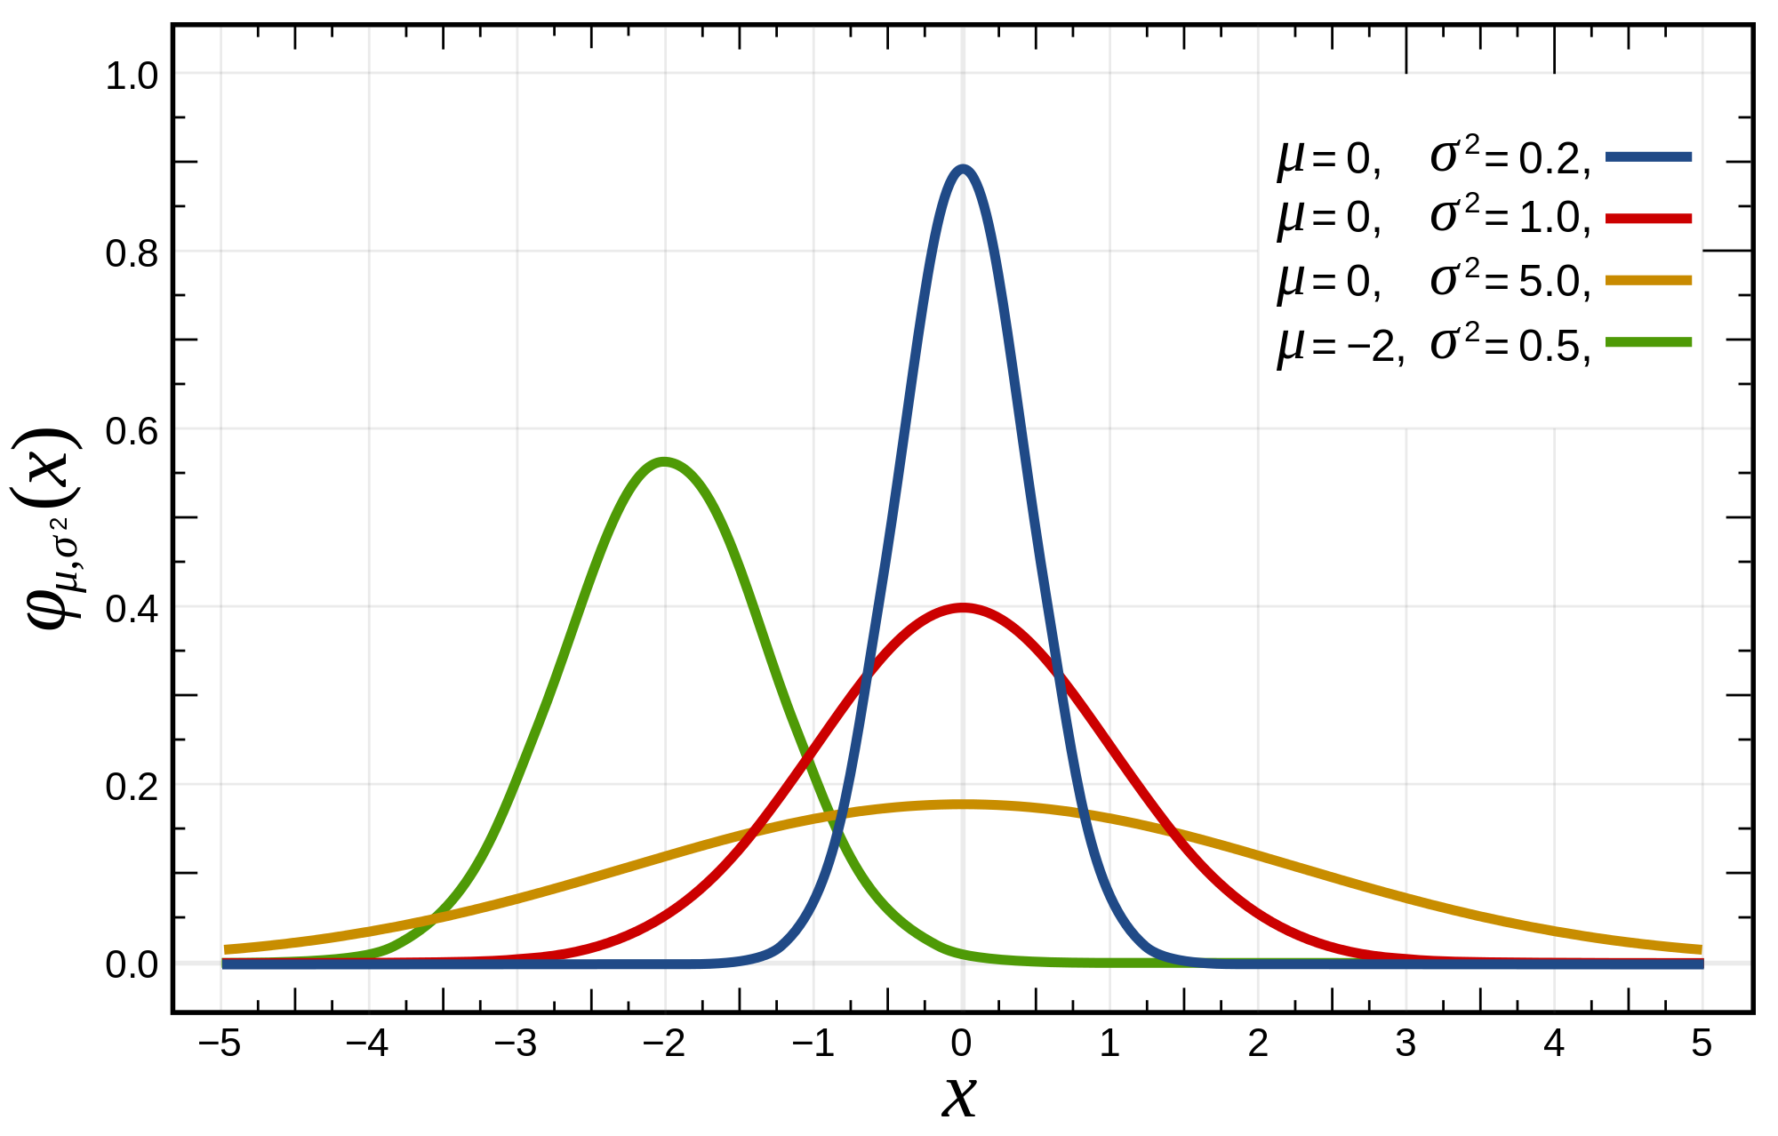
Basic Statistical Descriptions of Data
Motivation
To better understand the data: central tendency, variation and spread
Data dispersion characteristics
Median, max, min, quantiles, outliers, variance, ...
Numerical dimensions correspond to sorted intervals
Data dispersion:
Analyzed with multiple granularities of precision
Boxplot or quantile analysis on sorted intervals
Dispersion analysis on computed measures
Folding measures into numerical dimensions
Boxplot or quantile analysis on the transformed cube
Notes:
Note to self (MK): last part of slide does not clearly match slides that follow
Introduction slides:
In the current version, we only talk about numeric data. Can we add some materials about non-numeric data.
- text statistics, TF/IDF
- visualization of text statistics such as word cloud
- distribution of Internet (IN, SCC, OUT, …)
- visualization of social relationship (e.g., http://renlifang.msra.cn/)

Slide 15
Measuring the Central Tendency: (1) Mean
Mean (algebraic measure) (sample vs. population):
Note: n is sample size and N is population size.
Weighted arithmetic mean:
Trimmed mean:
Chopping extreme values (e.g., Olympics gymnastics score computation)

Slide 16
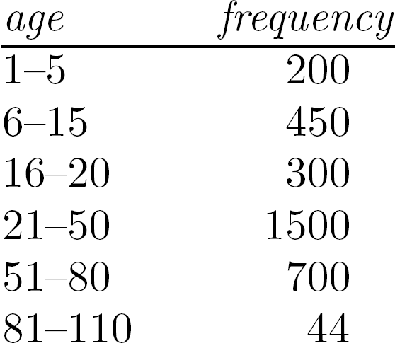
Measuring the Central Tendency: (2) Median
Median:
Middle value if odd number of values, or average of the middle two values otherwise
Estimated by interpolation (for grouped data):
Approximate median
Sum before the median interval
Interval width (L₂ – L₁)
Low interval limit

Slide 17
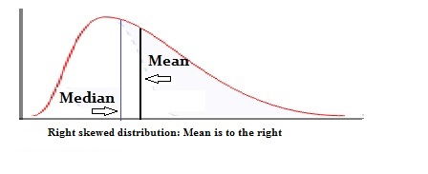
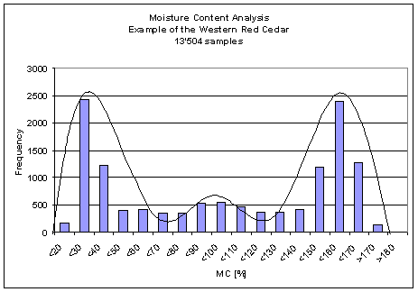
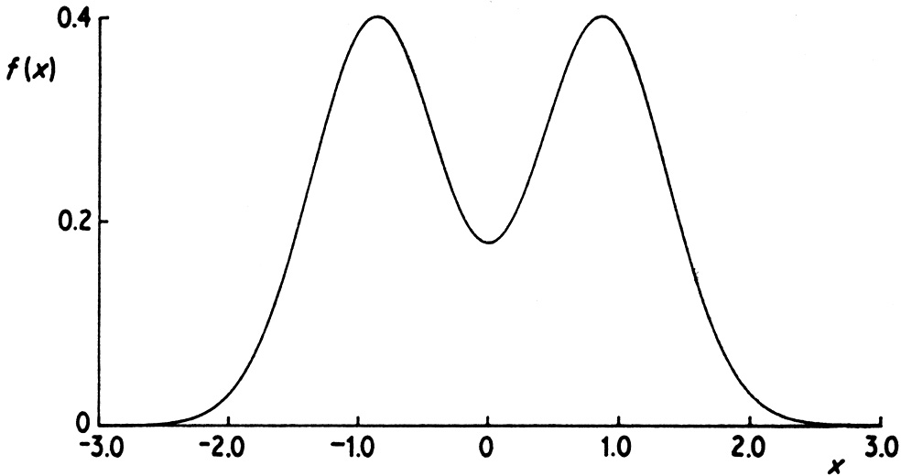
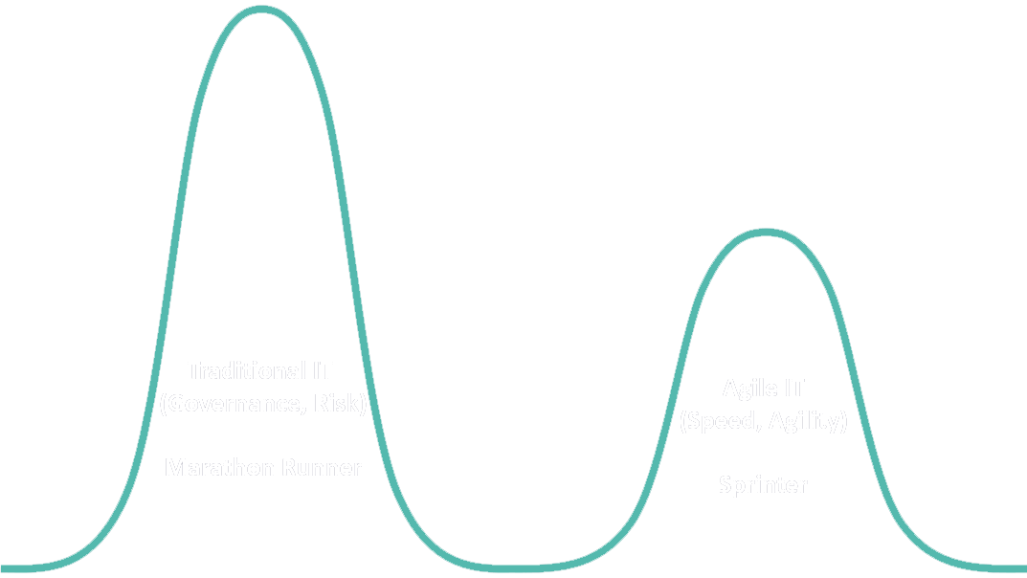
Measuring the Central Tendency: (3) Mode
Mode: Value that occurs most frequently in the data
Unimodal
Empirical formula:
Multi-modal
Bimodal
Trimodal

Slide 18
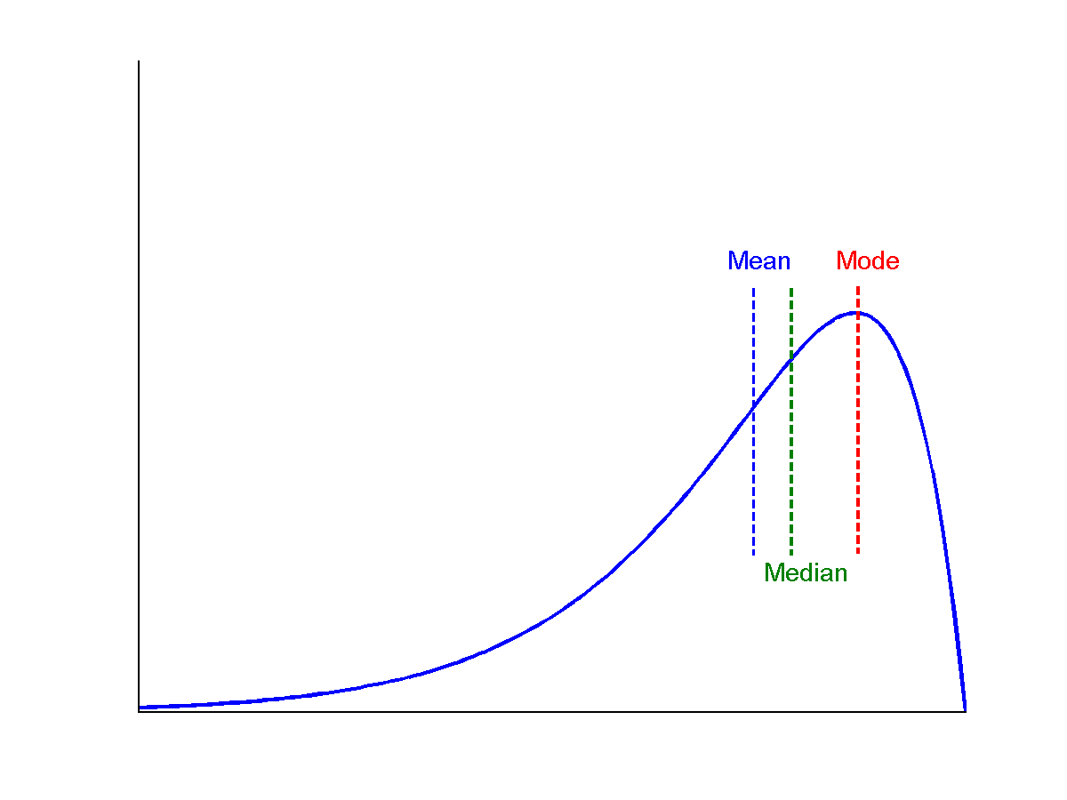
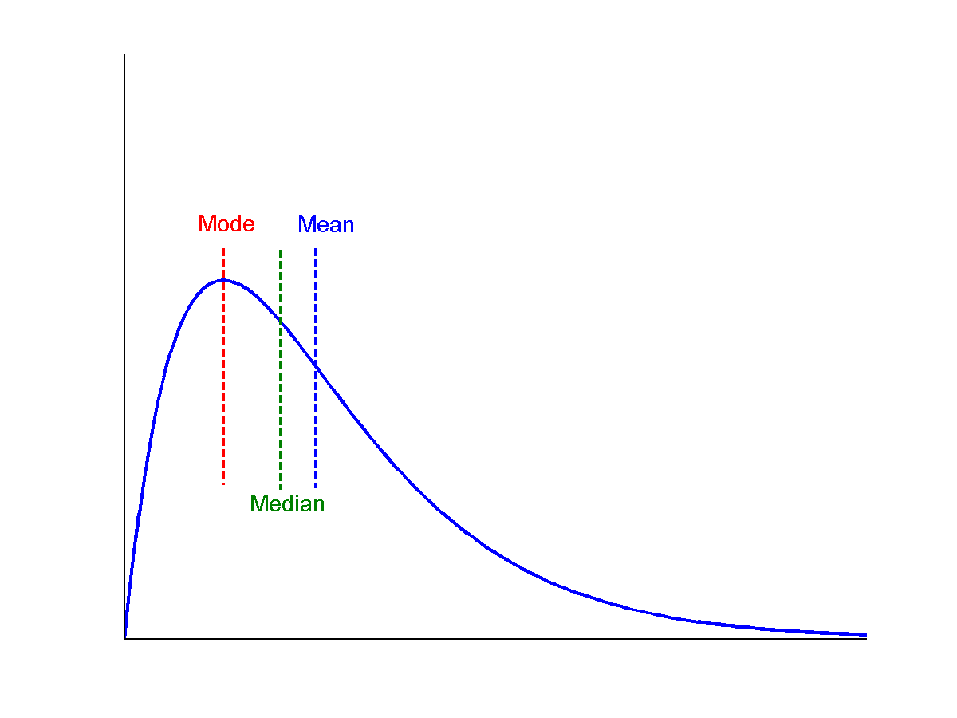
Symmetric vs. Skewed Data
symmetric
Median, mean and mode of symmetric, positively and negatively skewed data
positively skewed
negatively skewed

Slide 19
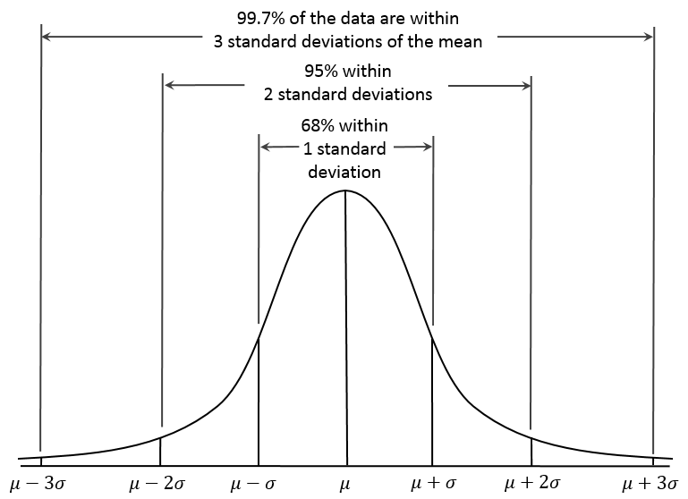
Properties of Normal Distribution Curve
← — ————Represent data dispersion, spread — ————→
Represent central tendency

Slide 20
Measures Data Distribution: Variance and Standard Deviation
Variance and standard deviation (sample: s, population: σ)
Variance: (algebraic, scalable computation)
Q: Can you compute it incrementally and efficiently?
Standard deviation s (or σ) is the square root of variance s² ⁽or σ²⁾
Note: The subtle difference of formulae for sample vs. population
n : the size of the sample
N : the size of the population

Slide 21
Graphic Displays of Basic Statistical Descriptions
Boxplot: graphic display of five-number summary
Histogram: x-axis are values, y-axis repres. frequencies
Quantile plot: each value x_{i} is paired with f_{i} indicating that approximately 100 f_{i} % of data are ≤ x_{i}
Quantile-quantile (q-q) plot: graphs the quantiles of one univariant distribution against the corresponding quantiles of another
Scatter plot: each pair of values is a pair of coordinates and plotted as points in the plane
Notes:
JH: Maybe we can remove Loess curve

Slide 22
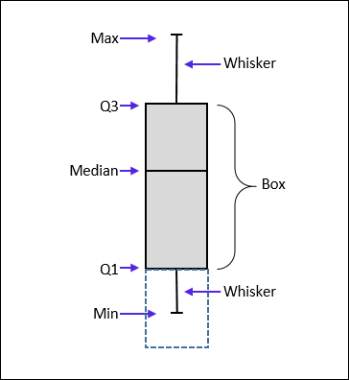
Measuring the Dispersion of Data: Quartiles & Boxplots
Quartiles: Q₁ (25th percentile), Q₃ (75th percentile)
Inter-quartile range: IQR = Q₃ – Q₁
Five number summary: min, Q₁, median, Q₃, max
Boxplot: Data is represented with a box
Q₁, Q₃, IQR: The ends of the box are at the first and third quartiles, i.e., the height of the box is IQR
Median (Q₂) is marked by a line within the box
Whiskers: two lines outside the box extended to Minimum and Maximum
Outliers: points beyond a specified outlier threshold, plotted individually
Outlier: usually, a value higher/lower than 1.5 x IQR

Slide 23
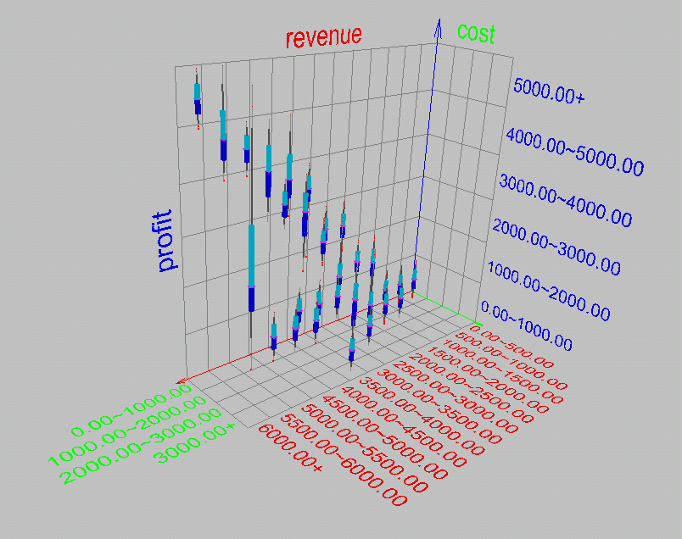
Visualization of Data Dispersion: 3-D Boxplots

Slide 24
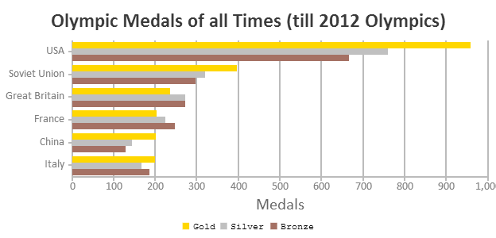
Histogram Analysis
Histogram
Histogram: Graph display of tabulated frequencies, shown as bars
Differences between histograms and bar charts
Histograms are used to show distributions of variables while bar charts are used to compare variables
Histograms plot binned quantitative data while bar charts plot categorical data
Bars can be reordered in bar charts but not in histograms
Differs from a bar chart in that it is the area of the bar that denotes the value, not the height as in bar charts, a crucial distinction when the categories are not of uniform width
Bar chart
Notes:
JH: A better and BASIC histogram figure --- because this one overlaps with a later one!

Slide 25
Histograms Often Tell More than Boxplots
The two histograms shown in the left may have the same boxplot representation
The same values for: min, Q1, median, Q3, max
But they have rather different data distributions

Slide 26
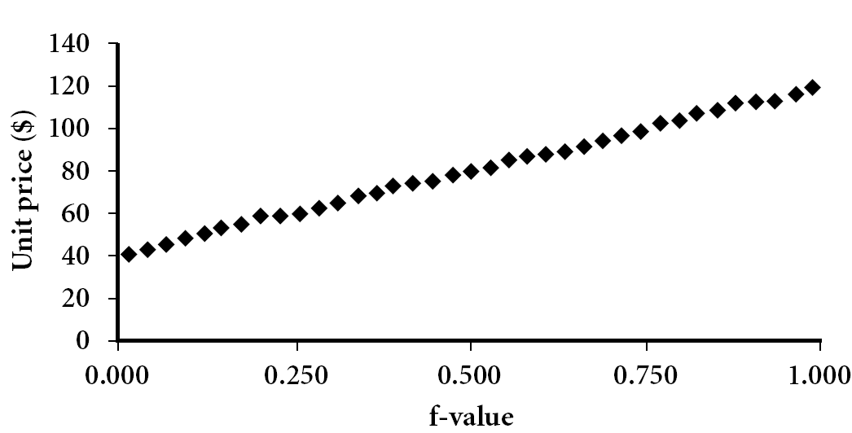
Quantile Plot
Displays all of the data (allowing the user to assess both the overall behavior and unusual occurrences)
Plots quantile information
For a data x_{i} data sorted in increasing order, f_{i} indicates that approximately 100 f_{i}% of the data are below or equal to the value x_{i}

Slide 27
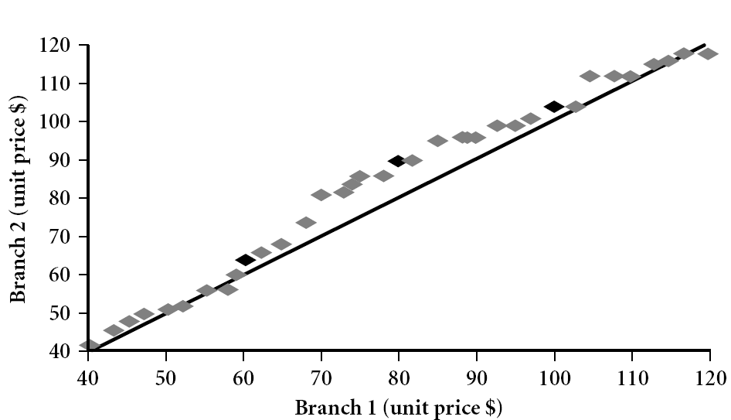
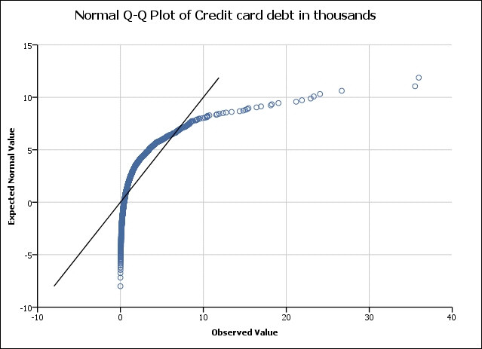
Quantile-Quantile (Q-Q) Plot
Graphs the quantiles of one univariate distribution against the corresponding quantiles of another
View: Is there is a shift in going from one distribution to another?
Example shows unit price of items sold at Branch 1 vs. Branch 2 for each quantile. Unit prices of items sold at Branch 1 tend to be lower than those at Branch 2
Notes:
Note: We need to label the dark plotted points as Q1, Median, Q3 – that would help in understanding this graph.
Tell audience: There is a shift in distribution of branch 1 WRT branch 2 in that the unit prices of items sold at branch 1 tend to be lower than those at branch 2.

Slide 28
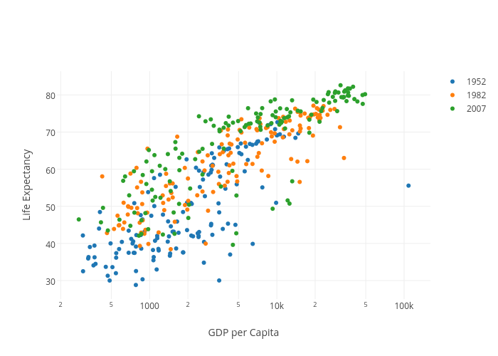
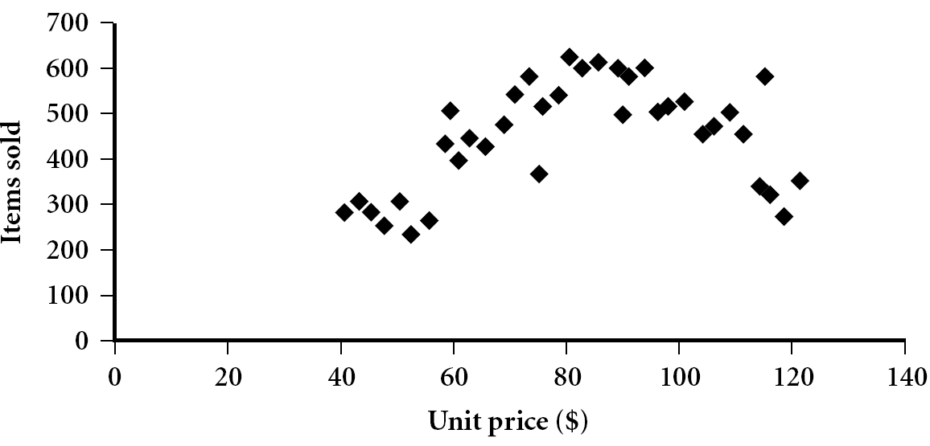
Scatter plot
Provides a first look at bivariate data to see clusters of points, outliers, etc.
Each pair of values is treated as a pair of coordinates and plotted as points in the plane
Notes:
Need a better and more MEANINGFUL scatter plot! -JH

Slide 29
Positively and Negatively Correlated Data
The left half fragment is positively correlated
The right half is negative correlated

Slide 30
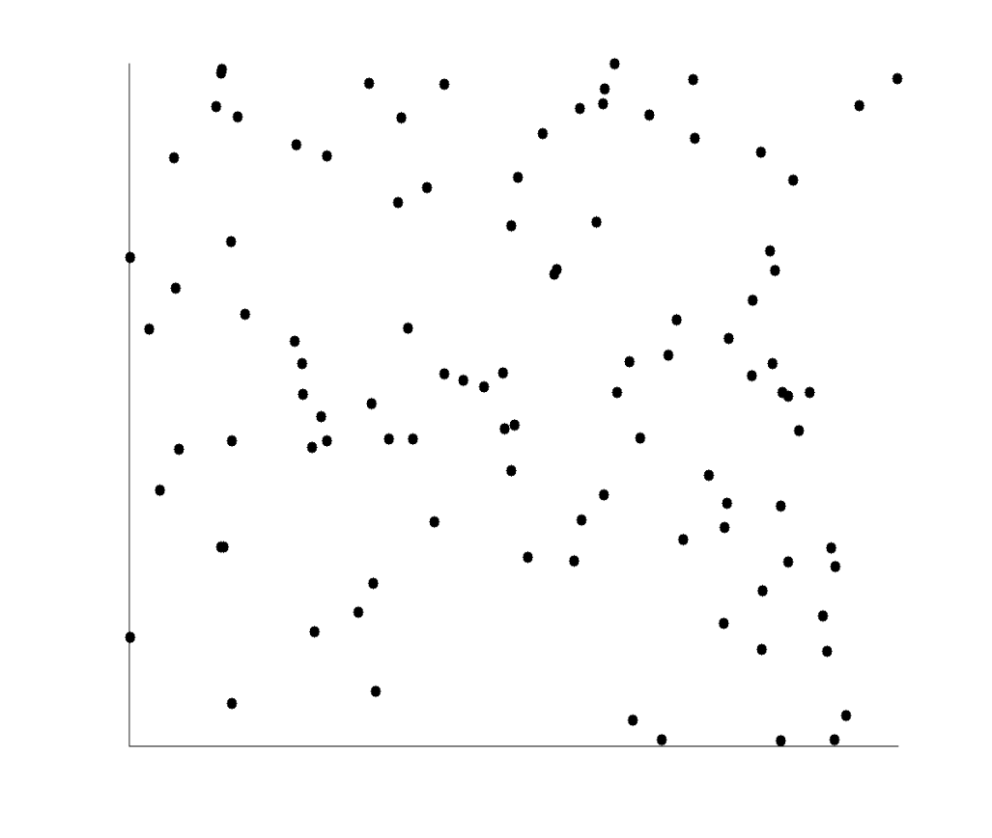
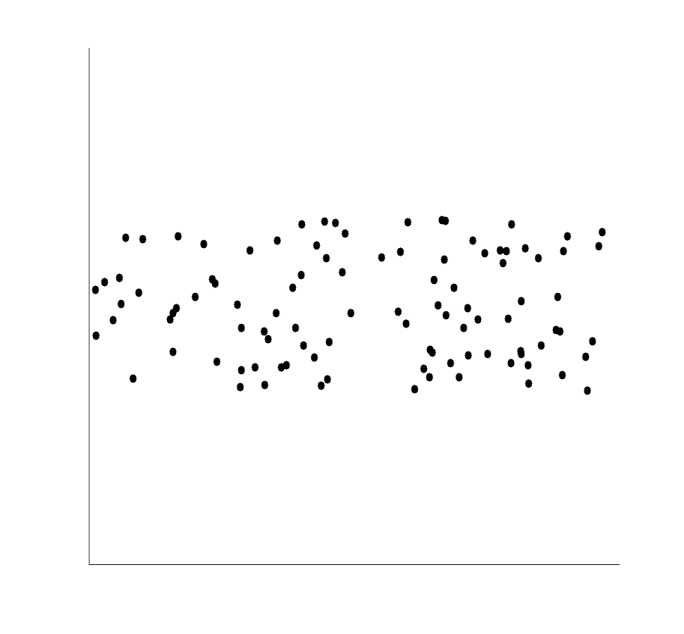
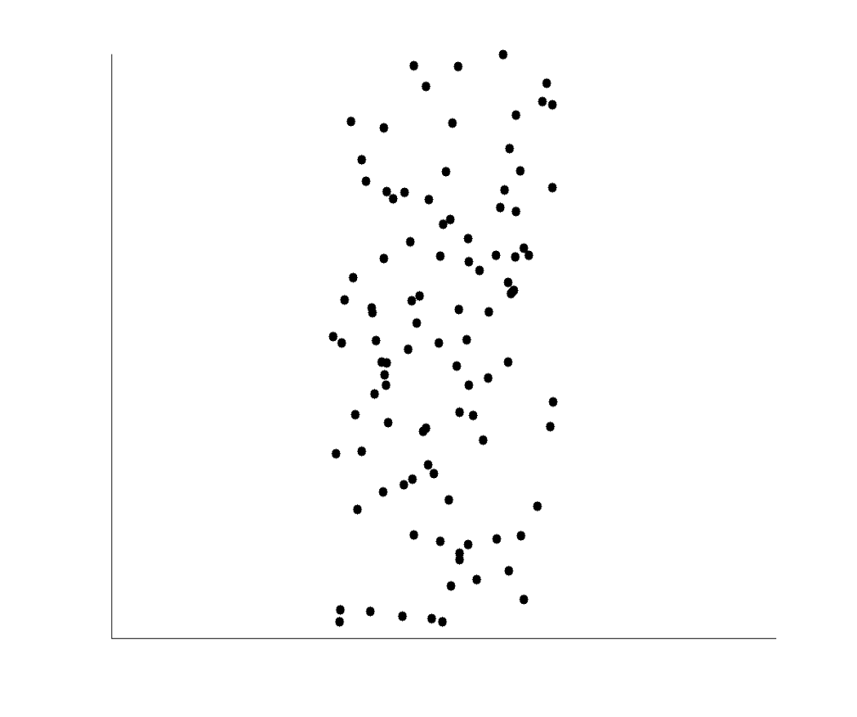
Uncorrelated Data

Slide 31
Chapter 2. Getting to Know Your Data
Data Objects and Attribute Types
Basic Statistical Descriptions of Data
Data Visualization
Measuring Data Similarity and Correlation
Summary

Slide 32
Data Visualization
Why data visualization?
Gain insight into an information space by mapping data onto graphical primitives
Provide qualitative overview of large data sets
Search for patterns, trends, structure, irregularities, relationships among data
Help find interesting regions and suitable parameters for further quantitative analysis
Provide a visual proof of computer representations derived
Categorization of visualization methods:
Pixel-oriented visualization techniques
Geometric projection visualization techniques
Icon-based visualization techniques
Hierarchical visualization techniques
Visualizing complex data and relations
Notes:
CC (conference call) 08.11.02: Need to check Wiki to update references.

Slide 33
Pixel-Oriented Visualization Techniques
For a data set of m dimensions, create m windows on the screen, one for each dimension
The m dimension values of a record are mapped to m pixels at the corresponding positions in the windows
The colors of the pixels reflect the corresponding values
Income
(b) Credit Limit
(c) transaction volume
(d) age
Notes:
33
CC (conference call) 08.11.02: Need to check Wiki to update references.

Slide 34
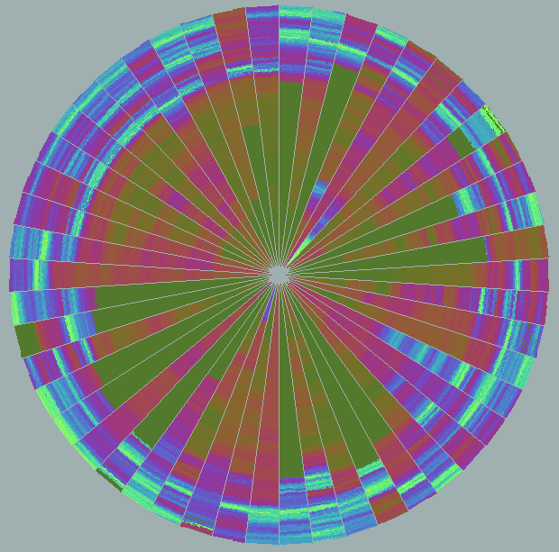
Laying Out Pixels in Circle Segments
To save space and show the connections among multiple dimensions, space filling is often done in a circle segment
Representing a data record in circle segment
(b) Laying out pixels in circle segment
Representing about 265,000 50-dimensional Data Items with the ‘Circle Segments’ Technique
Notes:
34

Slide 35
Geometric Projection Visualization Techniques
Visualization of geometric transformations and projections of the data
Methods
Direct visualization
Scatterplot and scatterplot matrices
Landscapes
Projection pursuit technique: Help users find meaningful projections of multidimensional data
Prosection views
Hyperslice
Parallel coordinates
Notes:
CC 08/11/02: Need a good survey. JH or JP may find a good book on amazon in order to update this slide. JH’s colleagues may generate some images for book.
We may consider the following books.
Visualizing Data: Exploring and Explaining Data with the Processing Environment - Paperback - Illustrated (Jan 11, 2008) by Ben Fry.
JH: I have ordered the book.

Slide 36
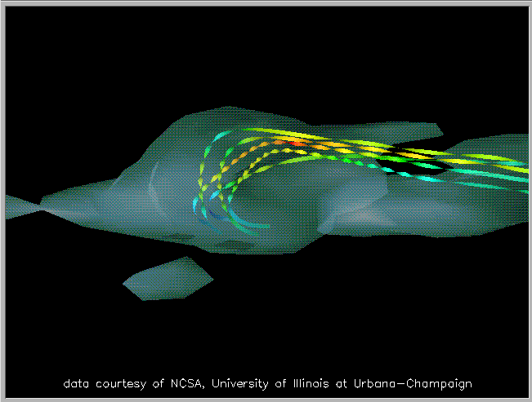
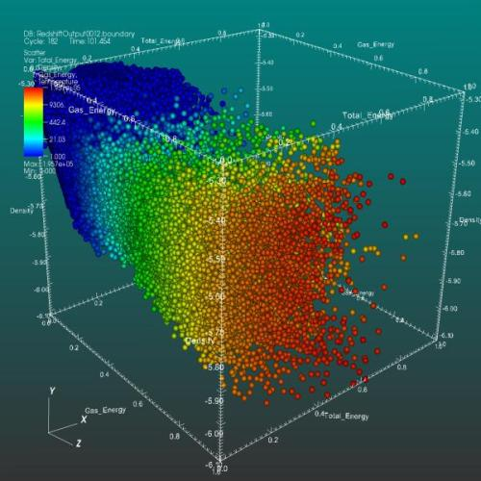
Direct Data Visualization
Ribbons with Twists Based on Vorticity
From Wiki: Scatter plot: A 3D scatter plot to visualize multivariate data
Notes:
http://books.elsevier.com/companions/1558606890/pictures/Chapter_01/fig1-6b.gif

Slide 37
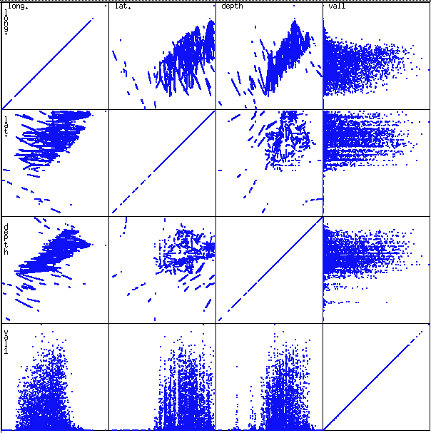
Scatterplot Matrices
Matrix of scatterplots (x-y-diagrams) of the k-dim. data
A total of k(k-1)/2 distinct scatterplots
Used by ermission of M. Ward, Worcester Polytechnic Institute

Slide 38
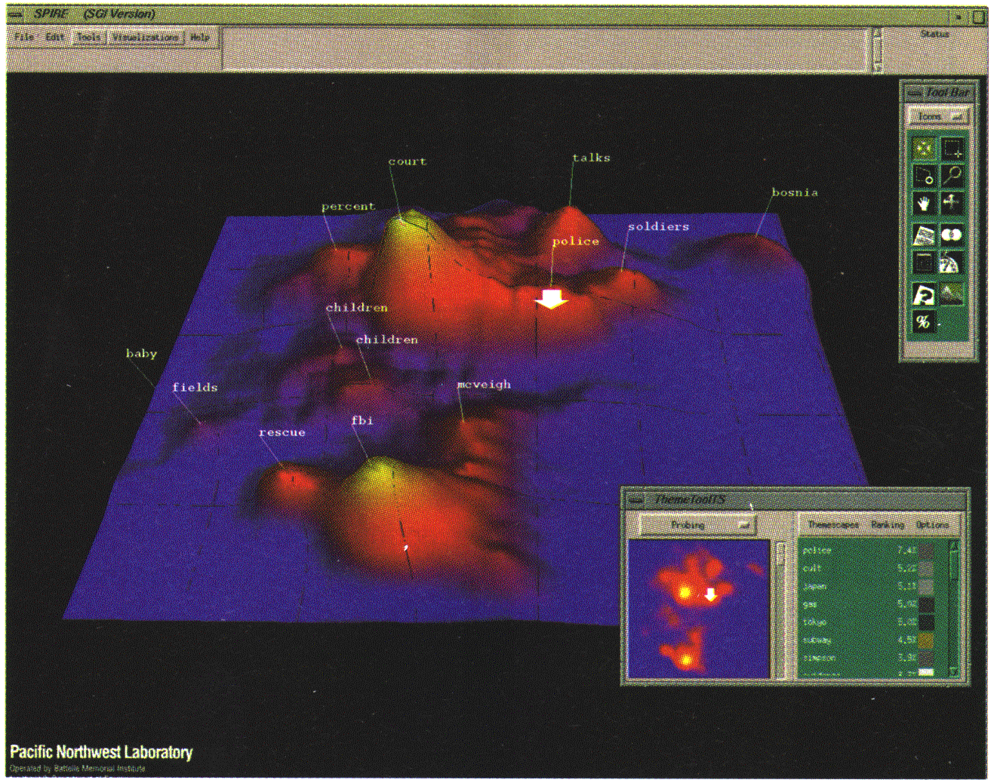
Landscapes
Visualization of the data as perspective landscape
The data needs to be transformed into a (possibly artificial) 2D spatial representation which preserves the characteristics of the data
Used by permission of B. Wright, Visible Decisions Inc.
news articles visualized as a landscape

Slide 39
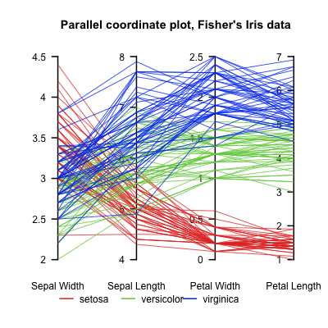
Parallel Coordinates
n equidistant axes which are parallel to one of the screen axes and correspond to the attributes
The axes are scaled to the [minimum, maximum]: range of the corresponding attribute
Every data item corresponds to a polygonal line which intersects each of the axes at the point which corresponds to the value for the attribute

Slide 40
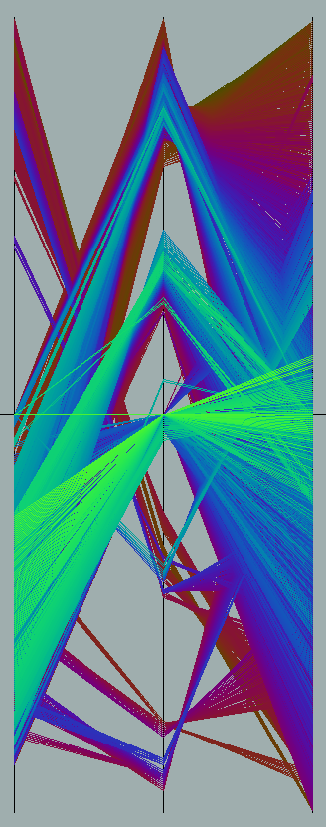
Parallel Coordinates of a Data Set

Slide 41
Icon-Based Visualization Techniques
Visualization of the data values as features of icons
Typical visualization methods
Chernoff Faces
Stick Figures
General techniques
Shape coding: Use shape to represent certain information encoding
Color icons: Use color icons to encode more information
Tile bars: Use small icons to represent the relevant feature vectors in document retrieval

Slide 42
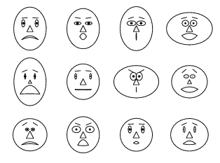
Chernoff Faces
A way to display variables on a two-dimensional surface, e.g., let x be eyebrow slant, y be eye size, z be nose length, etc.
The figure shows faces produced using 10 characteristics--head eccentricity, eye size, eye spacing, eye eccentricity, pupil size, eyebrow slant, nose size, mouth shape, mouth size, and mouth opening): Each assigned one of 10 possible values, generated using Mathematica (S. Dickson)
REFERENCE: Gonick, L. and Smith, W. The Cartoon Guide to Statistics. New York: Harper Perennial, p. 212, 1993
Weisstein, Eric W. "Chernoff Face." From MathWorld--A Wolfram Web Resource. mathworld.wolfram.com/ChernoffFace.html

Slide 43
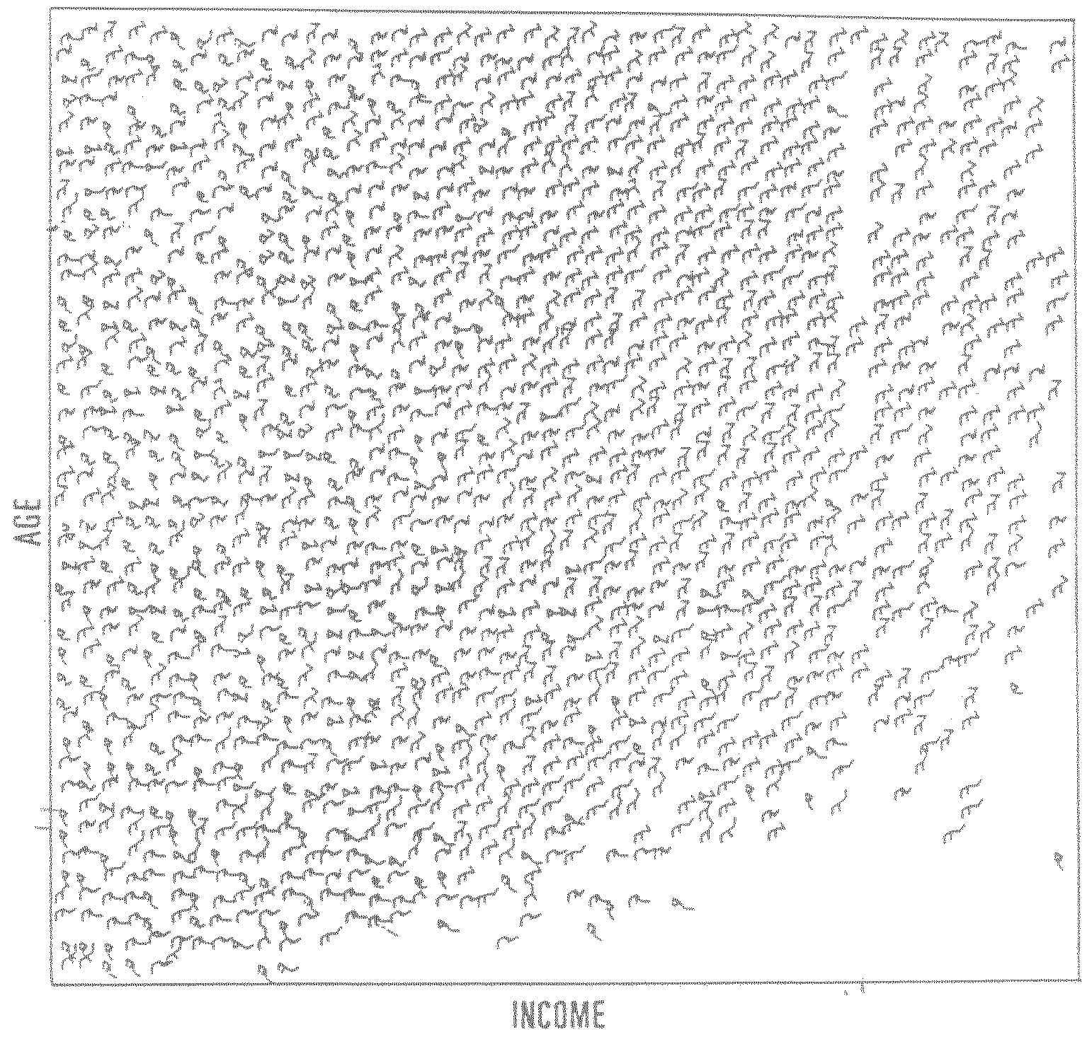
Stick Figure
A census data figure showing age, income, gender, education, etc.
A 5-piece stick figure (1 body and 4 limbs w. different angle/length)
used by permission of G. Grinstein, University of Massachusettes at Lowell
Notes:
“two attributes mapped to axes, remaining attributes mapped to angle or length of limbs”. Look at texture pattern.

Slide 44
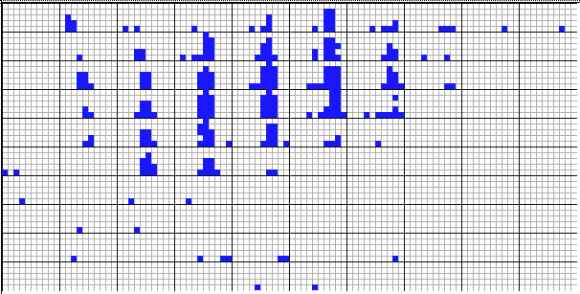
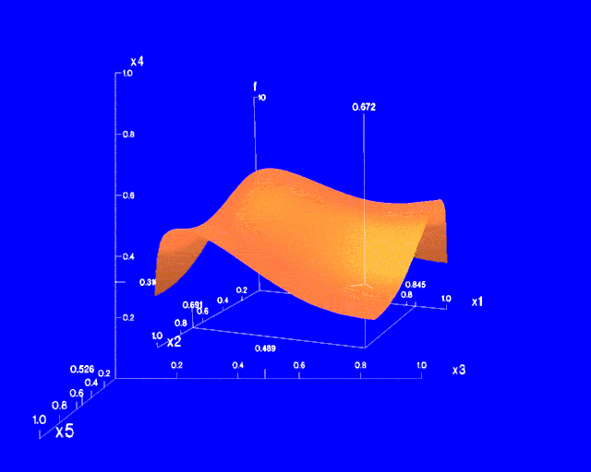
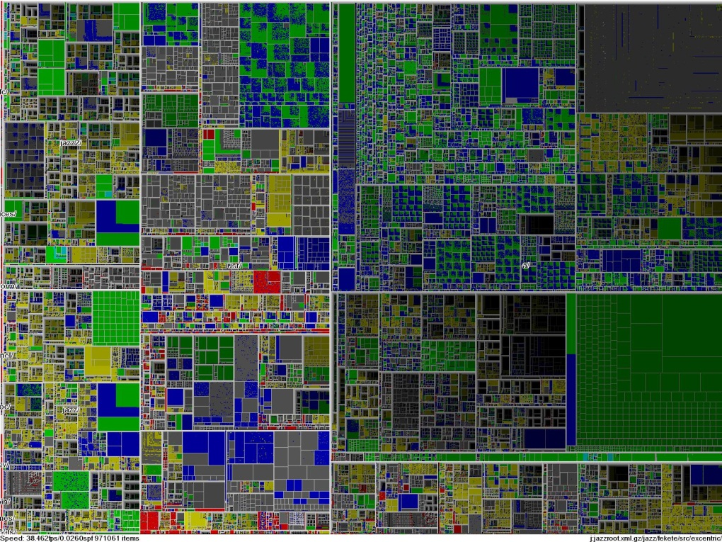
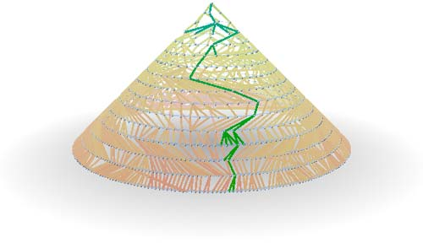

Hierarchical Visualization Techniques
Visualization of the data using a hierarchical partitioning into subspaces
Methods
Dimensional Stacking
Worlds-within-Worlds
Tree-Map
Cone Trees
InfoCube
Notes:
MK 08/10/18: Is it “Treemap” or “Tree-Map”? - inconsistent in this file.

Slide 45
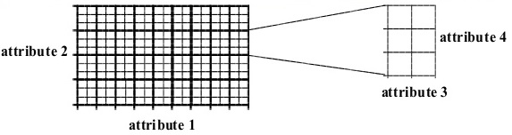
Dimensional Stacking
Partitioning of the n-dimensional attribute space in 2-D subspaces, which are ‘stacked’ into each other
Partitioning of the attribute value ranges into classes. The important attributes should be used on the outer levels.
Adequate for data with ordinal attributes of low cardinality
But, difficult to display more than nine dimensions
Important to map dimensions appropriately

Slide 46
Dimensional Stacking
Used by permission of M. Ward, Worcester Polytechnic Institute
Visualization of oil mining data with longitude and latitude mapped to the outer x-, y-axes and ore grade and depth mapped to the inner x-, y-axes

Slide 47
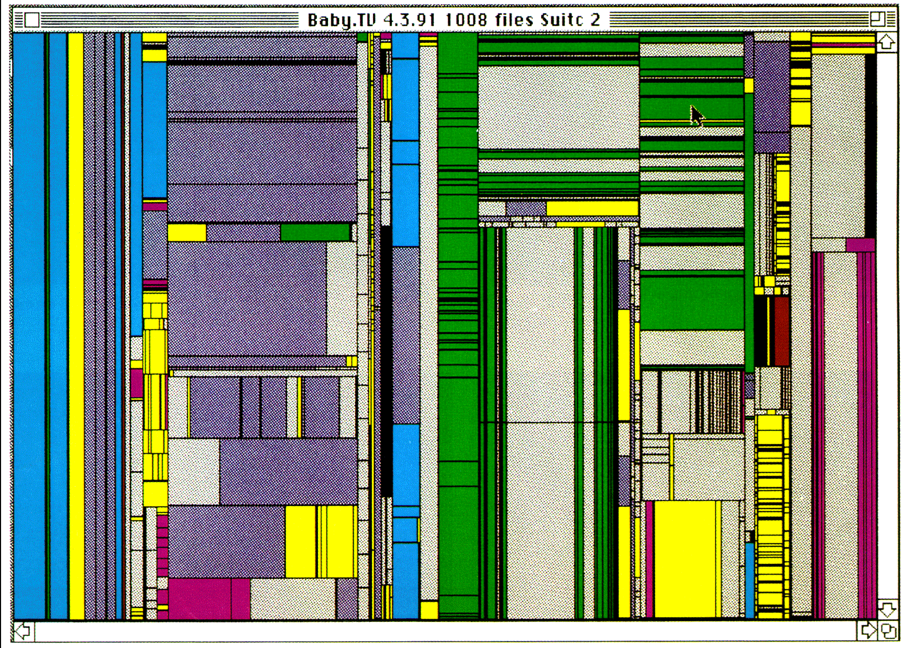
Tree-Map
Screen-filling method which uses a hierarchical partitioning of the screen into regions depending on the attribute values
The x- and y-dimension of the screen are partitioned alternately according to the attribute values (classes)
Schneiderman@UMD: Tree-Map of a File System
Schneiderman@UMD: Tree-Map to support large data sets of a million items
Notes:
Picture: http://www.cs.umd.edu/hcil/treemap-history/

Slide 48
InfoCube
A 3-D visualization technique where hierarchical information is displayed as nested semi-transparent cubes
The outermost cubes correspond to the top level data, while the subnodes or the lower level data are represented as smaller cubes inside the outermost cubes, etc.
Notes:
JH: I have not found a good infocube picture on the web

Slide 49
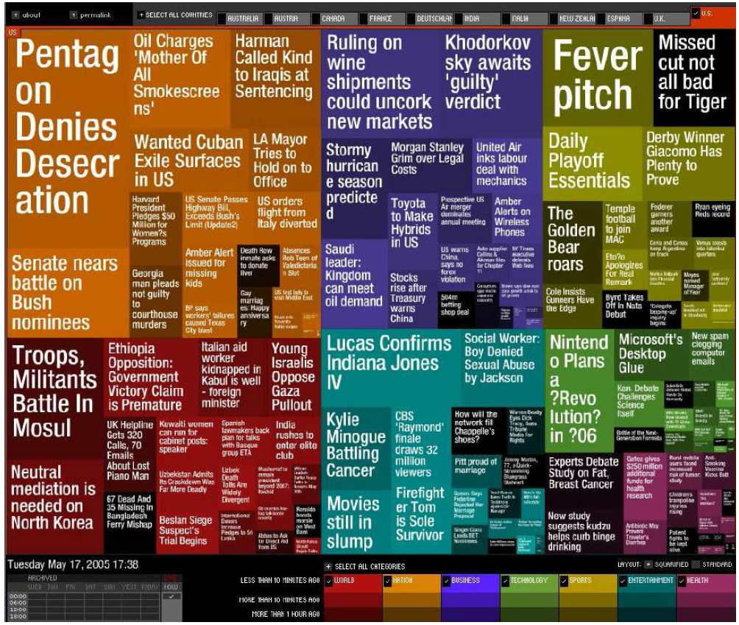

Visualizing Complex Data and Relations: Tag Cloud
Tag cloud: Visualizing user-generated tags
The importance of tag is represented by font size/color
Popularly used to visualize word/phrase distributions
KDD 2013 Research Paper Title Tag Cloud
Newsmap: Google News Stories in 2005

Slide 50
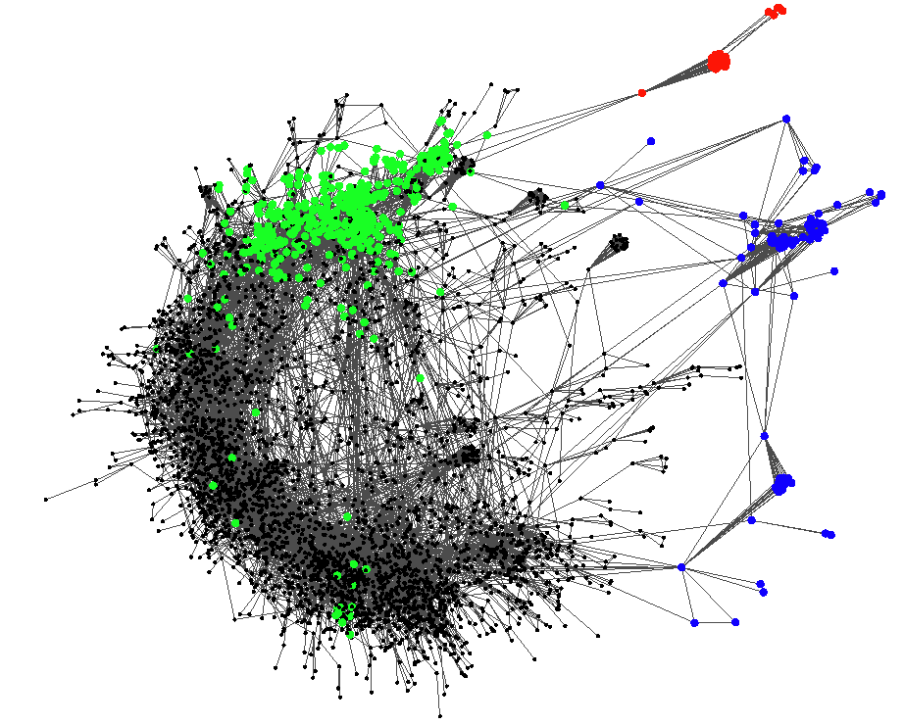
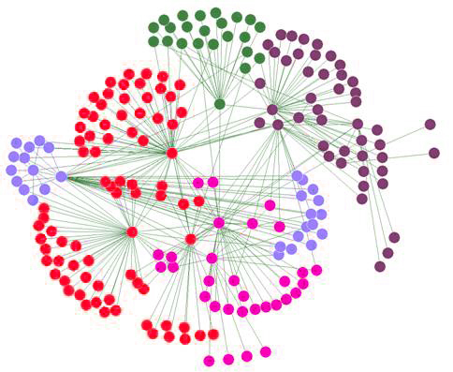
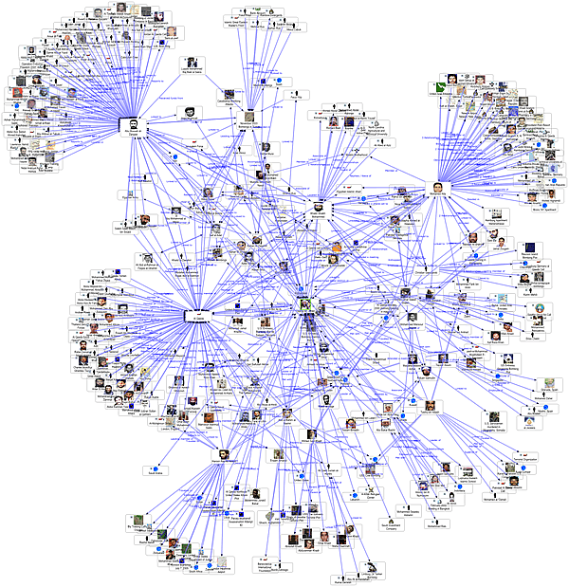
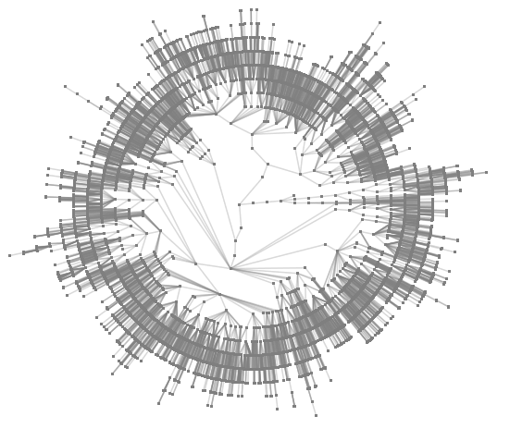
Visualizing Complex Data and Relations: Social Networks
Visualizing non-numerical data: social and information networks
organizing information networks
A typical network structure
A social network

Slide 51
Chapter 2. Getting to Know Your Data
Data Objects and Attribute Types
Basic Statistical Descriptions of Data
Data Visualization
Measuring Data Similarity and Correlation
Summary

Slide 52
Similarity, Dissimilarity, and Proximity
Similarity measure or similarity function
A real-valued function that quantifies the similarity between two objects
Measure how two data objects are alike: The higher value, the more alike
Often falls in the range [0,1]: 0: no similarity; 1: completely similar
Dissimilarity (or distance) measure
Numerical measure of how different two data objects are
In some sense, the inverse of similarity: The lower, the more alike
Minimum dissimilarity is often 0 (i.e., completely similar)
Range [0, 1] or [0, ∞) , depending on the definition
Proximity usually refers to either similarity or dissimilarity

Slide 53
Data Matrix and Dissimilarity Matrix
Data matrix
A data matrix of n data points with l dimensions
Dissimilarity (distance) matrix
n data points, but registers only the distance d(i, j) (typically metric)
Usually symmetric, thus a triangular matrix
Distance functions are usually different for real, boolean, categorical, ordinal, ratio, and vector variables
Weights can be associated with different variables based on applications and data semantics

Slide 54
Standardizing Numeric Data
Z-score:
X: raw score to be standardized, μ: mean of the population, σ: standard deviation
the distance between the raw score and the population mean in units of the standard deviation
negative when the raw score is below the mean, “+” when above
An alternative way: Calculate the mean absolute deviation
where
standardized measure (z-score):
Using mean absolute deviation is more robust than using standard deviation
Notes:
MK: For lecture, this may be OK here, but I think discussion of standardization/normalization is better kept all together in Chapter 3

Slide 55
Example: Data Matrix and Dissimilarity Matrix
Data Matrix
Dissimilarity Matrix (by Euclidean Distance)

Slide 56
Distance on Numeric Data: Minkowski Distance
Minkowski distance: A popular distance measure
where i = (x_{i1}, x_{i2}, …, x_{il}) and j = (x_{j1}, x_{j2}, …, x_{jl}) are two l-dimensional data objects, and p is the order (the distance so defined is also called L-p norm)
Properties
d(i, j) > 0 if i ≠ j, and d(i, i) = 0 (Positivity)
d(i, j) = d(j, i) (Symmetry)
d(i, j) ≤ d(i, k) + d(k, j) (Triangle Inequality)
A distance that satisfies these properties is a metric
Note: There are nonmetric dissimilarities, e.g., set differences

Slide 57
Special Cases of Minkowski Distance
p = 1: (L₁ norm) Manhattan (or city block) distance
E.g., the Hamming distance: the number of bits that are different between two binary vectors
p = 2: (L₂ norm) Euclidean distance
p → ∞: (L_{max} norm, L∞ norm) “supremum” distance
The maximum difference between any component (attribute) of the vectors

Slide 58
Example: Minkowski Distance at Special Cases
Manhattan (L₁)
Euclidean (L₂)
Supremum (L∞)

Slide 59
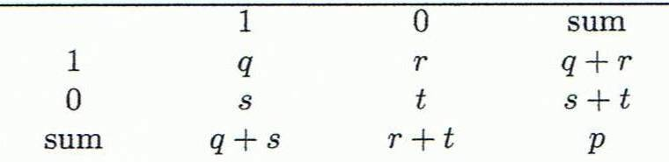
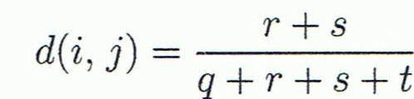


Proximity Measure for Binary Attributes
A contingency table for binary data
Distance measure for symmetric binary variables:
Distance measure for asymmetric binary variables:
Jaccard coefficient (similarity measure for asymmetric binary variables):
Note: Jaccard coefficient is the same as “coherence”:
Object j
Object i
(a concept discussed in Pattern Discovery)

Slide 60
Example: Dissimilarity between Asymmetric Binary Variables
Mary
 | 1 | 0 | ∑_{row}
1 | 2 | 0 | 2
0 | 1 | 3 | 4
∑_{col} | 3 | 3 | 6
Jack
Gender is a symmetric attribute (not counted in)
The remaining attributes are asymmetric binary
Let the values Y and P be 1, and the value N be 0
Distance:
Jim
 | 1 | 0 | ∑_{row}
1 | 1 | 1 | 2
0 | 1 | 3 | 4
∑_{col} | 2 | 4 | 6
Jack
Mary
 | 1 | 0 | ∑_{row}
1 | 1 | 1 | 2
0 | 2 | 2 | 4
∑_{col} | 3 | 3 | 6
Jim

Slide 61
Proximity Measure for Categorical Attributes
Categorical data, also called nominal attributes
Example: Color (red, yellow, blue, green), profession, etc.
Method 1: Simple matching
m: # of matches, p: total # of variables
Method 2: Use a large number of binary attributes
Creating a new binary attribute for each of the M nominal states

Slide 62
Ordinal Variables
An ordinal variable can be discrete or continuous
Order is important, e.g., rank (e.g., freshman, sophomore, junior, senior)
Can be treated like interval-scaled
Replace an ordinal variable value by its rank:
Map the range of each variable onto [0, 1] by replacing i-th object in the f-th variable by
Example: freshman: 0; sophomore: 1/3; junior: 2/3; senior 1
Then distance: d(freshman, senior) = 1, d(junior, senior) = 1/3
Compute the dissimilarity using methods for interval-scaled variables

Slide 63
Attributes of Mixed Type
A dataset may contain all attribute types
Nominal, symmetric binary, asymmetric binary, numeric, and ordinal
One may use a weighted formula to combine their effects:
If f is numeric: Use the normalized distance
If f is binary or nominal: d_{ij}^{(f)} = 0 if x_{if} = x_{jf}; or d_{ij}^{(f)} = 1 otherwise
If f is ordinal
Compute ranks z_{if} (where )
Treat z_{if} as interval-scaled

Slide 64

Cosine Similarity of Two Vectors
A document can be represented by a bag of terms or a long vector, with each attribute recording the frequency of a particular term (such as word, keyword, or phrase) in the document
Other vector objects: Gene features in micro-arrays
Applications: Information retrieval, biologic taxonomy, gene feature mapping, etc.
Cosine measure: If d₁ and d₂ are two vectors (e.g., term-frequency vectors), then
where • indicates vector dot product, ||d||: the length of vector d

Slide 65

Example: Calculating Cosine Similarity
Calculating Cosine Similarity:
where • indicates vector dot product, ||d||: the length of vector d
Ex: Find the similarity between documents 1 and 2.
d₁ = (5, 0, 3, 0, 2, 0, 0, 2, 0, 0) d₂ = (3, 0, 2, 0, 1, 1, 0, 1, 0, 1)
First, calculate vector dot product
d₁•d₂ = 5 X 3 + 0 X 0 + 3 X 2 + 0 X 0 + 2 X 1 + 0 X 1 + 0 X 1 + 2 X 1 + 0 X 0 + 0 X 1 = 25
Then, calculate ||d₁|| and ||d₂||
Calculate cosine similarity: cos(d₁, d₂ ) = 25/ (6.481 X 4.12) = 0.94

Slide 66
Correlation Analysis (for Categorical Data)
Χ² (chi-square) test:
Null hypothesis: The two distributions are independent
The cells that contribute the most to the Χ² value are those whose actual count is very different from the expected count
The larger the Χ² value, the more likely the variables are related
Note: Correlation does not imply causality
# of hospitals and # of car-theft in a city are correlated
Both are causally linked to the third variable: population

Slide 67
Chi-Square Calculation: An Example
 | Play chess | Not play chess | Sum (row)
Like science fiction | 250 (X1) | 200 (X2) | 450
Not like science fiction | 50 (X3) | 1000 (X4) | 1050
Sum(col.) | 300 | 1200 | 1500
Null hypothesis: The two distributions are independent
What does that mean?
The ratio between people who play chess vs not play chess is the same for both groups of like science fiction and not like science fiction
X1:X2=X3:X4=300:1200
X1:X3=X2:X4=450:1050
X1+X2=450 X3+X4=1050
X1+X3=300 X2+X4=1200

Slide 68
Chi-Square Calculation: An Example
 | Play chess | Not play chess | Sum (row)
Like science fiction | 250 (90) | 200 (360) | 450
Not like science fiction | 50 (210) | 1000 (840) | 1050
Sum(col.) | 300 | 1200 | 1500
How to derive 90?
450/1500 * 300 = 90
We can reject the
null hypothesis of
independence at a confidence level of 0.001
Χ² (chi-square) calculation (numbers in parenthesis are expected counts calculated based on the data distribution in the two categories)
It shows that like_science_fiction and play_chess are correlated in the group

Slide 69
Chi-Square Calculation: An Example
 | A | B | C | D | Sum (row)
1 |  |  |  |  | 200
0 |  |  |  |  | 1000
Sum(col.) | 300 | 300 | 300 | 300 | 1200
Degree of freedom
(#categories_in_variable_A -1)((#categories_in_variable_B -1)
number of values that are free to vary

Slide 70

Chi-Square Calculation: An Example
 | Play chess | Not play chess | Sum (row)
Like science fiction | 250 (90) | 200 (360) | 450
Not like science fiction | 50 (210) | 1000 (840) | 1050
Sum(col.) | 300 | 1200 | 1500
We can reject the
null hypothesis of
independence at a confidence level of 0.001
Degree of freedom =?

Slide 71

Variance for Single Variable (Numerical Data)
The variance of a random variable X provides a measure of how much the value of X deviates from the mean or expected value of X:
where σ² is the variance of X, σ is called standard deviation
µ is the mean, and µ = E[X] is the expected value of X
That is, variance is the expected value of the square deviation from the mean
It can also be written as:
Sample variance
$$s^{2}=\frac{1}{n}\sum_{i}^{n}{{\left(x_{i}−\hat{μ}\right)}^{2}} s^{2}=\frac{1}{n−1}\sum_{i}^{n}{{\left(x_{i}−\hat{μ}\right)}^{2}}$$

Slide 72

Covariance for Two Variables
Covariance between two variables X₁ and X₂
where µ₁ = E[X₁] is the respective mean or expected value of X₁; similarly for µ₂
Sample covariance between X₁ and X₂: ${\hat{σ}}_{12}=\frac{1}{n}\sum_{i=1}^{n}{\left(x_{i1}−\hat{μ_{1}}\right)\left(x_{i2}−\hat{μ_{2}}\right)}$
Sample covariance is a generalization of the sample variance: ${\hat{σ}}_{11}=\frac{1}{n}\sum_{i=1}^{n}{\left(x_{i1}−\hat{μ_{1}}\right)\left(x_{i1}−\hat{μ_{1}}\right)}$
Positive covariance: If σ₁₂ > 0
Negative covariance: If σ₁₂ < 0

Slide 73


Covariance for Two Variables
Independence: If X₁ and X₂ are independent, σ₁₂ = 0 but the reverse is not true
Some pairs of random variables may have a covariance 0 but are not independent
Only under some additional assumptions (e.g., the data follow multivariate normal distributions) does a covariance of 0 imply independence
Example:
$E(X_{1})$=?
$E(X_{2})$=?
$E(X_{1}X_{2})$=?
$$X_{1}$$ | 1 | -1
$$X_{2}$$ | 0 | 1 | -1

Slide 74
Example: Calculation of Covariance
Suppose two stocks X₁ and X₂ have the following values in one week:
(2, 5), (3, 8), (5, 10), (4, 11), (6, 14)
Question: If the stocks are affected by the same industry trends, will their prices rise or fall together?
Covariance formula
Its computation can be simplified as:
E(X₁) = (2 + 3 + 5 + 4 + 6)/ 5 = 20/5 = 4
E(X₂) = (5 + 8 + 10 + 11 + 14) /5 = 48/5 = 9.6
σ₁₂ = (2×5 + 3×8 + 5×10 + 4×11 + 6×14)/5 − 4 × 9.6 = 4
Thus, X₁ and X₂ rise together since σ₁₂ > 0

Slide 75

Correlation between Two Numerical Variables
Correlation between two variables X₁ and X₂ is the standard covariance, obtained by normalizing the covariance with the standard deviation of each variable
Sample correlation for two attributes X₁ and X₂:
where n is the number of tuples, µ₁ and µ₂ are the respective means of X₁ and X₂ , σ₁ and σ₂ are the respective standard deviation of X₁ and X₂
If ρ₁₂ > 0: A and B are positively correlated (X₁’s values increase as X₂’s)
The higher, the stronger correlation
If ρ₁₂ = 0: independent (under the same assumption as discussed in co-variance)
If ρ₁₂ < 0: negatively correlated
$${\hat{ρ}}_{12}=\frac{{\hat{σ}}_{12}}{{\hat{σ}}_{1}{\hat{σ}}_{2}}=\frac{\sum_{i=1}^{n}{\left(x_{i1}−{\hat{μ}}_{1}\right)}\left(x_{i2}−{\hat{μ}}_{2}\right)}{\sqrt{\sum_{i=1}^{n}{{\left(x_{i1}−{\hat{μ}}_{1}\right)}^{2}}{\left(x_{i2}−{\hat{μ}}_{2}\right)}^{2}}}$$

Slide 76

Visualizing Changes of Correlation Coefficient
Correlation coefficient value range: [–1, 1]
A set of scatter plots shows sets of points and their correlation coefficients changing from –1 to 1

Slide 77
Covariance Matrix
The variance and covariance information for the two variables X₁ and X₂ can be summarized as 2 X 2 covariance matrix as
Generalizing it to d dimensions, we have,

Slide 78



KL Divergence: Comparing Two Probability Distributions
The Kullback-Leibler (KL) divergence: Measure the difference between two probability distributions over the same variable x
From information theory, closely related to relative entropy, information divergence, and information for discrimination
D_{KL}(p(x) || q(x)): divergence of q(x) from p(x), measuring the information lost when q(x) is used to approximate p(x)
Ack.: Wikipedia entry: The Kullback-Leibler (KL) divergence
Discrete form
Continuous form

Slide 79
More on KL Divergence
The KL divergence measures the expected number of extra bits required to code samples from p(x) (“true” distribution) when using a code based on q(x), which represents a theory, model, description, or approximation of p(x)
The KL divergence is not a distance measure, not a metric: asymmetric, not satisfy triangular inequality (D_{KL}(P‖Q) does not equal D_{KL}(Q‖P))
In applications, P typically represents the "true" distribution of data, observations, or a precisely calculated theoretical distribution, while Q typically represents a theory, model, description, or approximation of P.
The Kullback–Leibler divergence from Q to P, denoted D_{KL}(P‖Q), is a measure of the information gained when one revises one's beliefs from the prior probability distribution Q to the posterior probability distribution P. In other words, it is the amount of information lost when Q is used to approximate P.
The KL divergence is sometimes also called the information gain achieved if P is used instead of Q. It is also called the relative entropy of P with respect to Q.

Slide 80
Subtlety at Computing the KL Divergence
Base on the formula, D_{KL}(P,Q) ≥ 0 and D_{KL}(P || Q) = 0 if and only if P = Q
How about when p = 0 or q = 0?
lim_{p→0} p log p = 0
when p != 0 but q = 0, D_{KL}(p || q) is defined as ∞, i.e., if one event e is possible (i.e., p(e) > 0), and the other predicts it is absolutely impossible (i.e., q(e) = 0), then the two distributions are absolutely different
However, in practice, P and Q are derived from frequency distributions, not counting the possibility of unseen events. Thus smoothing is needed
Example: P : (a : 3/5, b : 1/5, c : 1/5). Q : (a : 5/9, b : 3/9, d : 1/9)
need to introduce a small constant ϵ, e.g., ϵ = 10⁻³
The sample set observed in P, SP = {a, b, c}, SQ = {a, b, d}, SU = {a, b, c, d}
Smoothing, add missing symbols to each distribution, with probability ϵ
P′ : (a : 3/5 − ϵ/3, b : 1/5 − ϵ/3, c : 1/5 − ϵ/3, d : ϵ)
Q′ : (a : 5/9 − ϵ/3, b : 3/9 − ϵ/3, c : ϵ, d : 1/9 − ϵ/3)
D_{KL}(P’ || Q’) can then be computed easily

Slide 81
Chapter 2. Getting to Know Your Data
Data Objects and Attribute Types
Basic Statistical Descriptions of Data
Data Visualization
Measuring Data Similarity and Correlation
Summary

Slide 82
Summary
Data attribute types: nominal, binary, ordinal, interval-scaled, ratio-scaled
Many types of data sets, e.g., numerical, text, graph, Web, image.
Gain insight into the data by:
Basic statistical data description: central tendency, dispersion, graphical displays
Data visualization: map data onto graphical primitives
Measure data similarity and correlation
Above steps are the beginning of data preprocessing
Many methods have been developed but still an active area of research
Notes:
08/10/23: This slide was out of date. Draft of new version above.
Cut out the following:
Data description, data exploration, and measure data similarity set the basis for quality data preprocessing
A lot of methods have been developed but data preprocessing still an active area of research

Slide 83
References
W. Cleveland, Visualizing Data, Hobart Press, 1993
T. Dasu and T. Johnson. Exploratory Data Mining and Data Cleaning. John Wiley, 2003
U. Fayyad, G. Grinstein, and A. Wierse. Information Visualization in Data Mining and Knowledge Discovery, Morgan Kaufmann, 2001
L. Kaufman and P. J. Rousseeuw. Finding Groups in Data: an Introduction to Cluster Analysis. John Wiley & Sons, 1990.
H. V. Jagadish et al., Special Issue on Data Reduction Techniques. Bulletin of the Tech. Committee on Data Eng., 20(4), Dec. 1997
D. A. Keim. Information visualization and visual data mining, IEEE trans. on Visualization and Computer Graphics, 8(1), 2002
D. Pyle. Data Preparation for Data Mining. Morgan Kaufmann, 1999
S. Santini and R. Jain,” Similarity measures”, IEEE Trans. on Pattern Analysis and Machine Intelligence, 21(9), 1999
E. R. Tufte. The Visual Display of Quantitative Information, 2nd ed., Graphics Press, 2001
C. Yu, et al., Visual data mining of multimedia data for social and behavioral studies, Information Visualization, 8(1), 2009
Notes:
MK 08.11.02: This needs to be updated to reflect changes.

Slide 84


